Slide 1
AES Implementation
Applied Cryptography - 6240
TEAM
Ramnarayanan Sankar (801409708)
Poojitha Jayareddygari (801426875)
Shashank Kolluru (801421839)

Slide 2
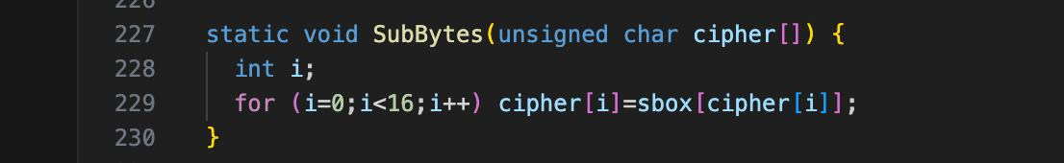
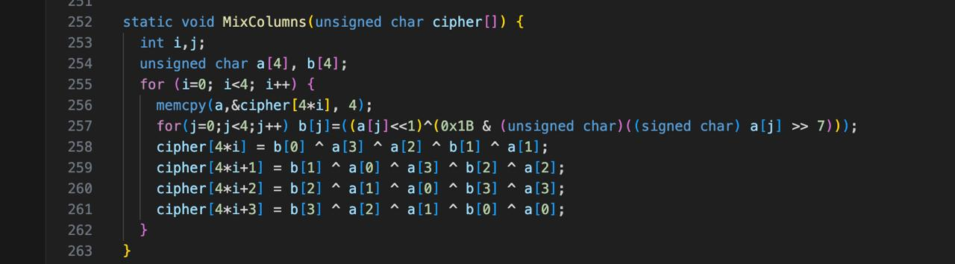
Source Code before changes - Encryption

Slide 3
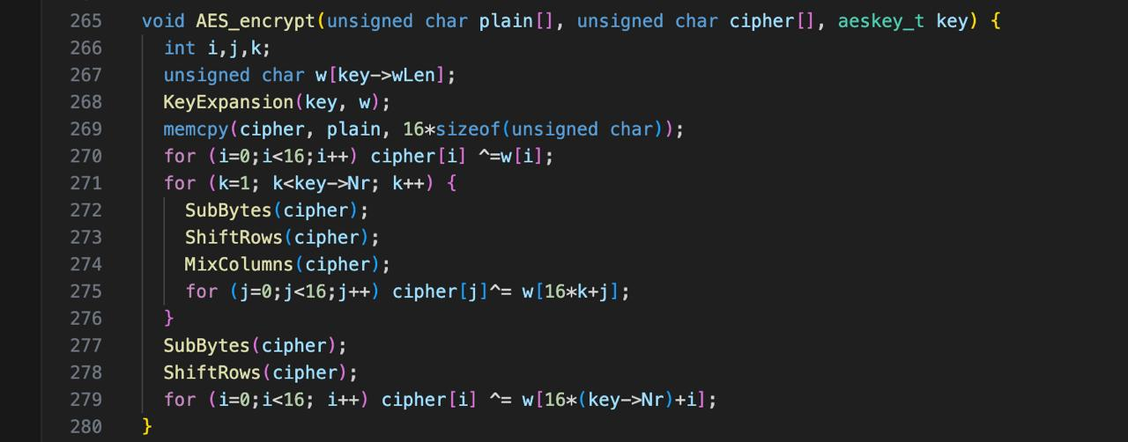
Source Code before changes - Encryption

Slide 4
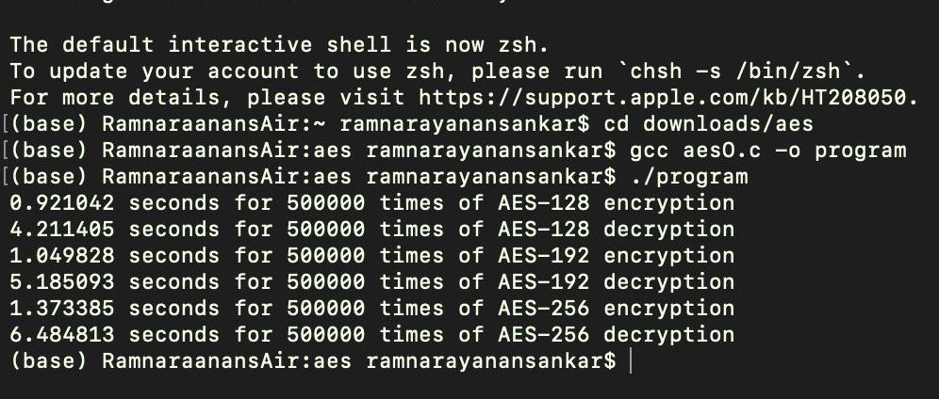
Original RUN TIME before changes
Encryption and Decryption
Original Source code Run time

Slide 5
Explanation
Source code changes for Encryption and Decryption:
We eliminated all 'for' loops within the SubBytes, MixColumns, and AES_Encrypt blocks, opting instead to assign values directly to the respective variables. This approach aims to improve efficiency and streamline the execution of these blocks.

Slide 6
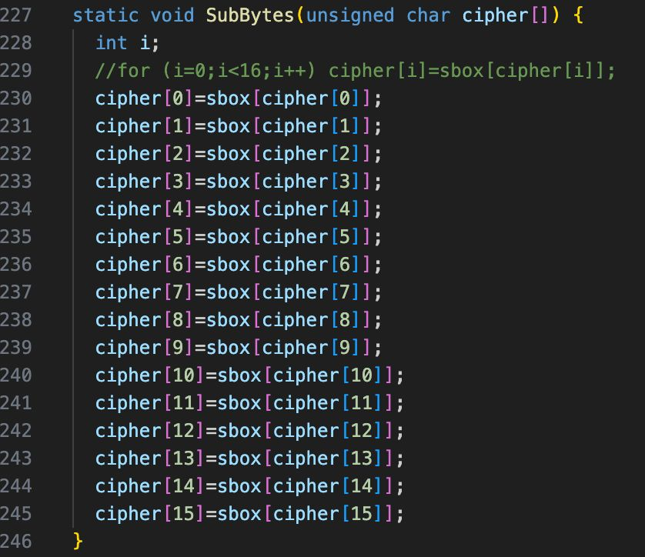
Source Code after changes - Encryption

Slide 7
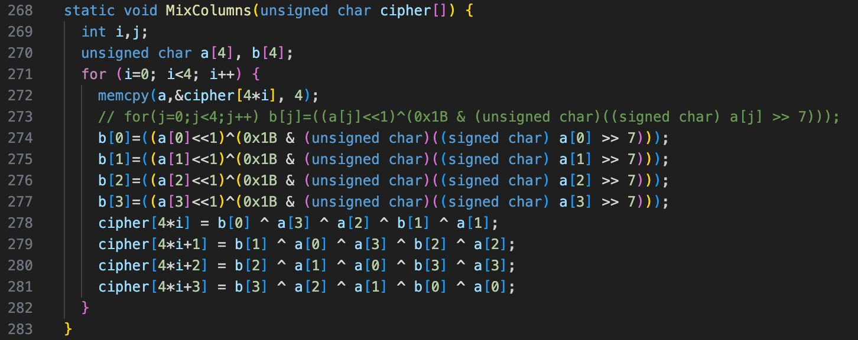
Source Code after changes

Slide 8
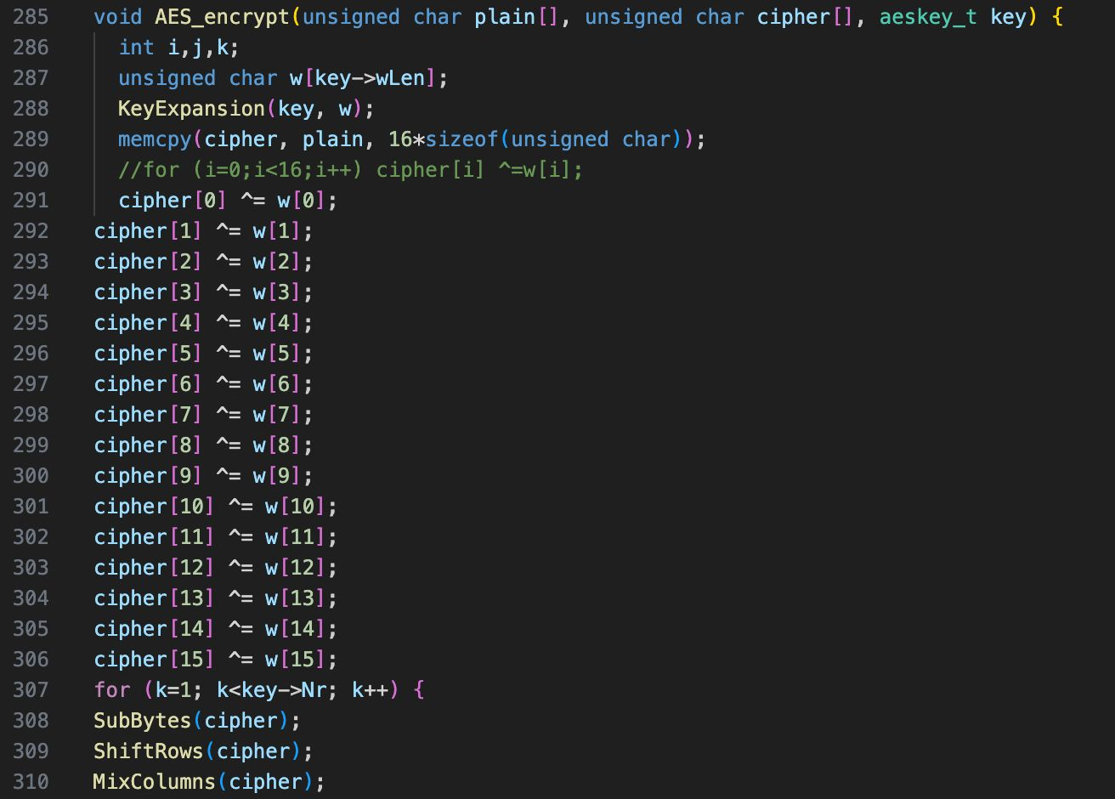
Source Code after changes

Slide 9
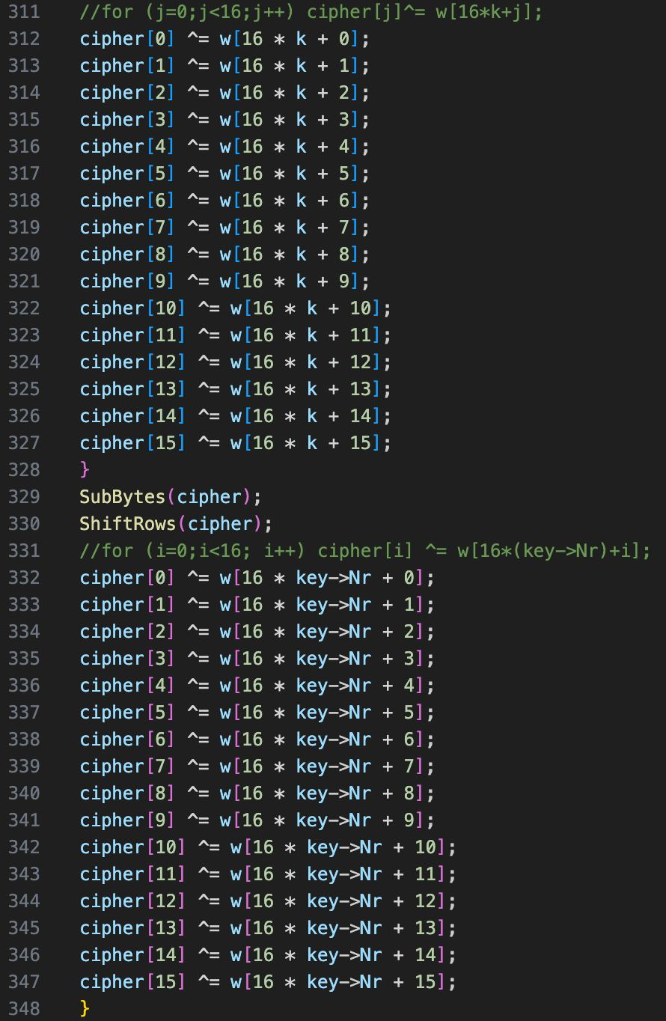

Slide 10
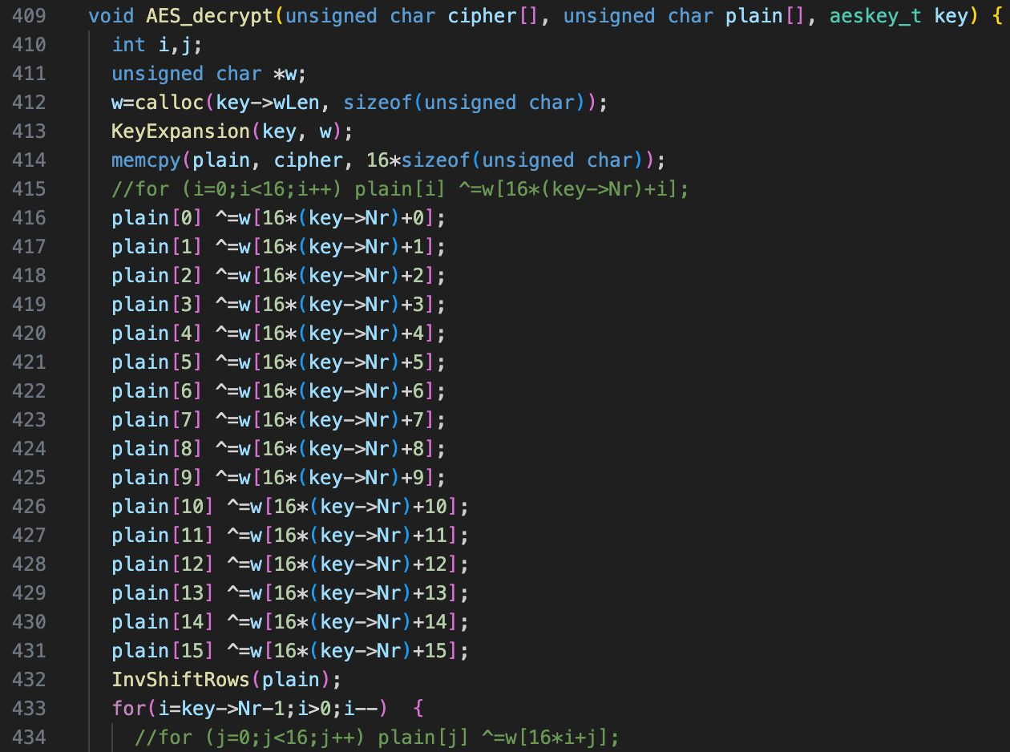
Source Code after changes - Decryption

Slide 11
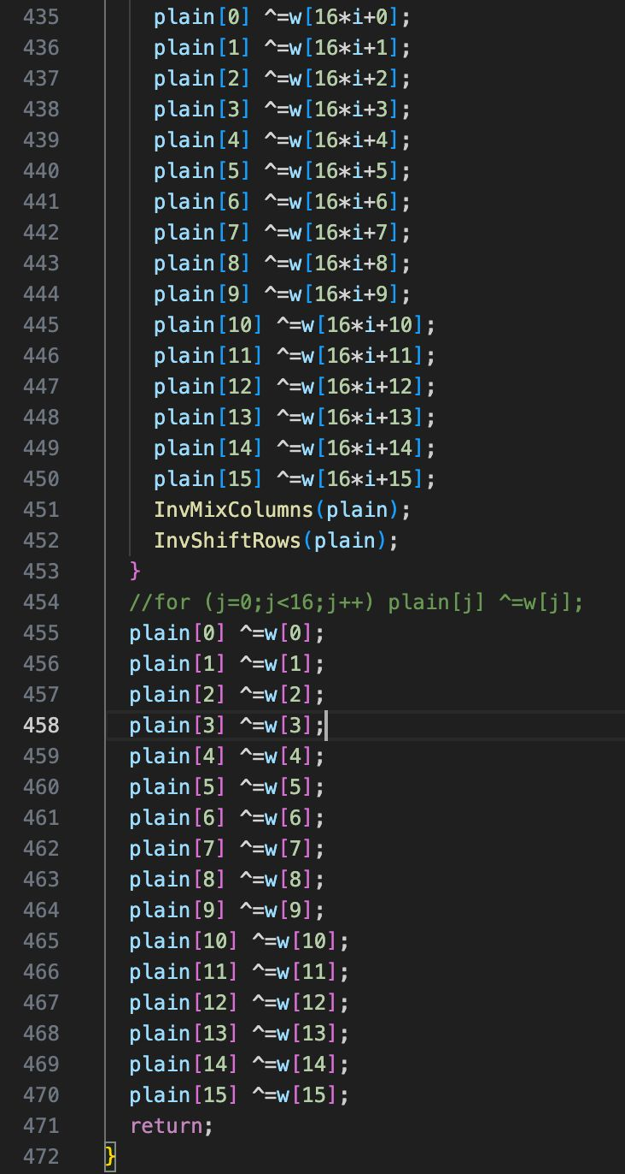

Slide 12
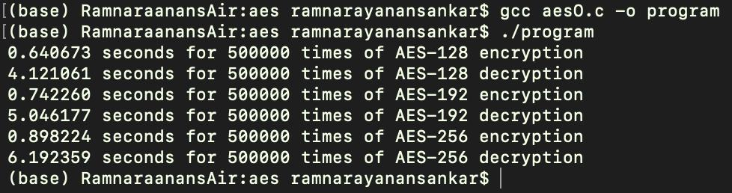
RUN TIME
Modified Run Time
Modified Run time for encryption and decryption

Slide 13
THANKYOU

